Slide 1
Git Basics
Module 2 – Continuous Integration

Slide 2
Continuous Integration Module 2 contents
Introducing Version Control
Git and GitHub setup
Using Git
Exercise!

Slide 3
Introducing Version Control
Continuous Integration – Module 2: Git Basics

Slide 4
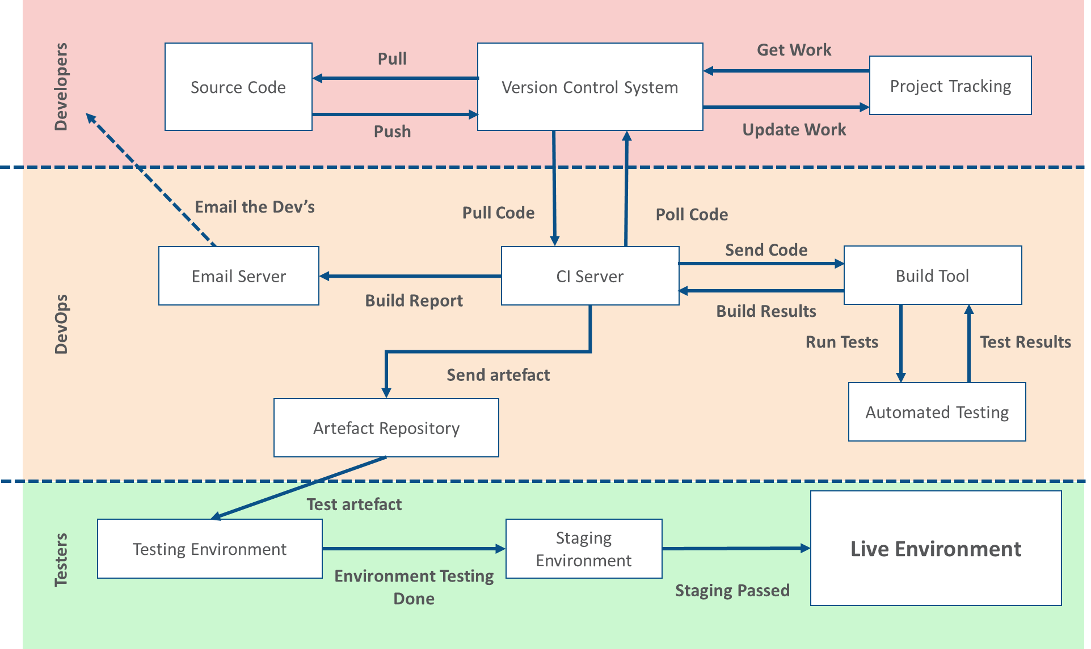
Evaluating the CI Pipeline

Slide 5
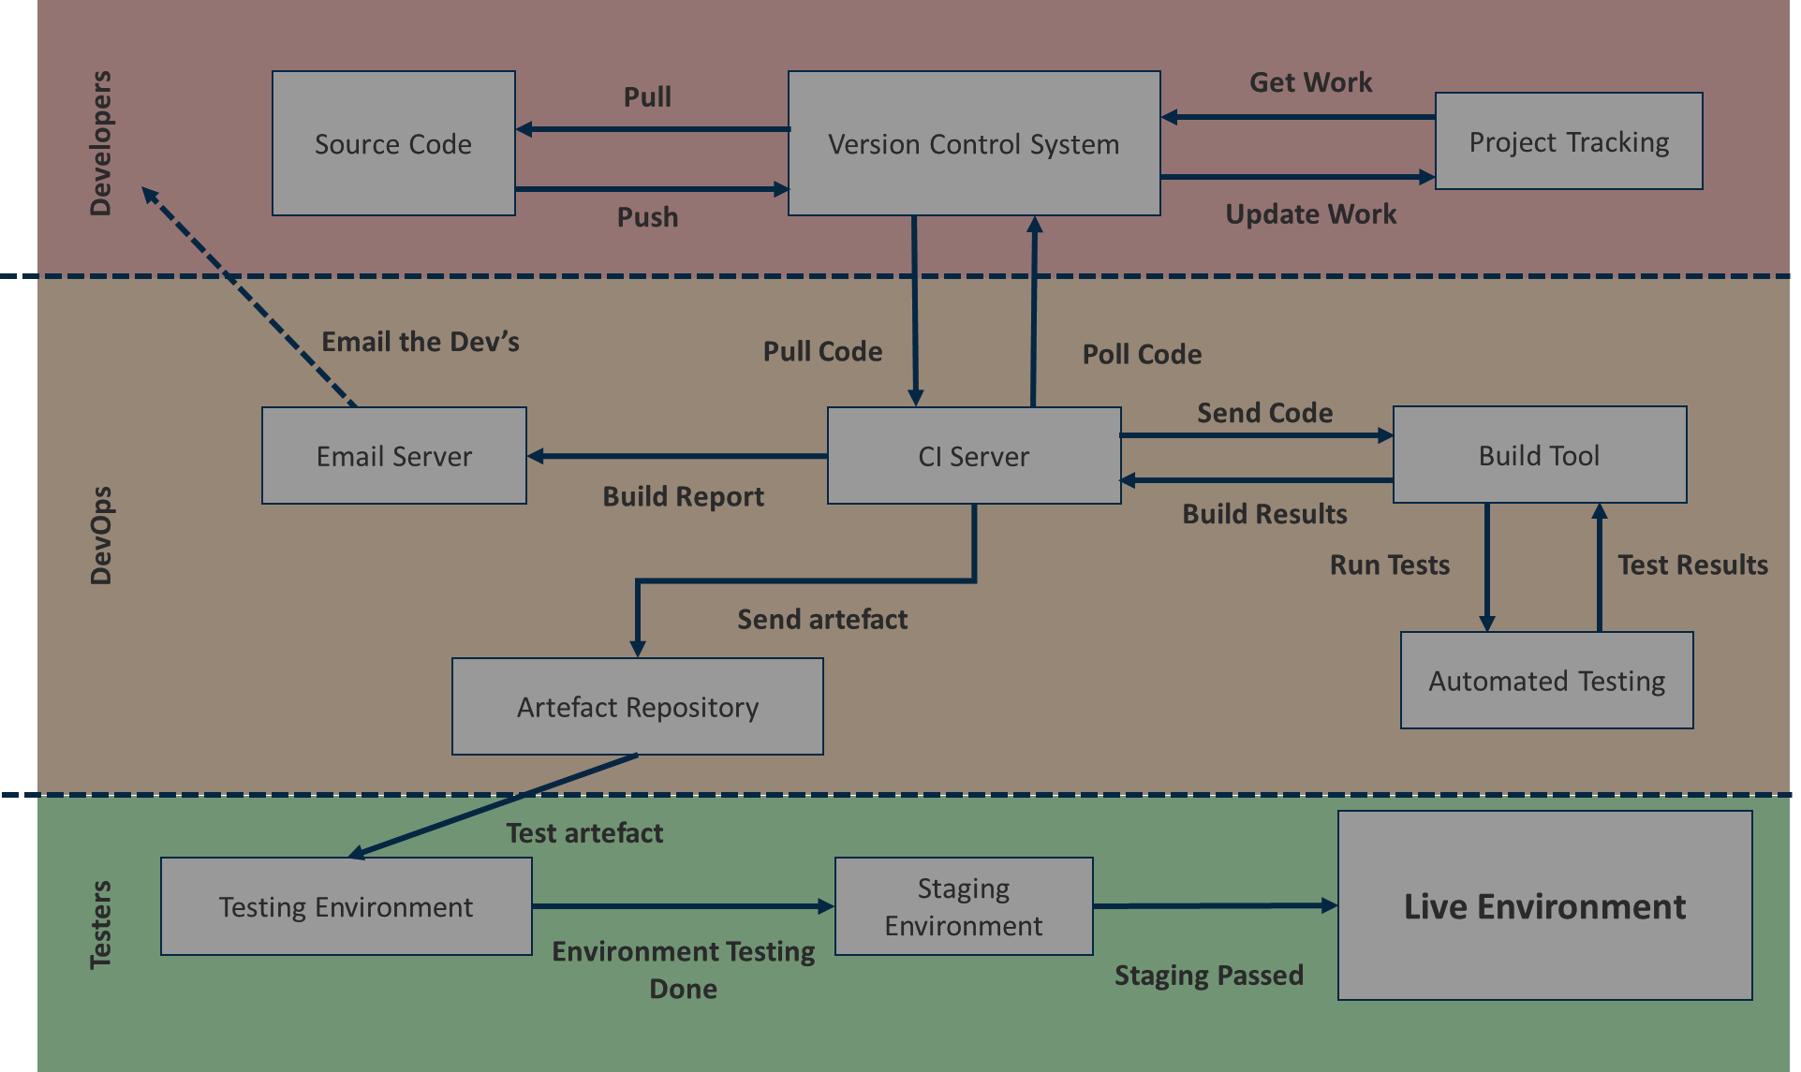
Evaluating the CI Pipeline

Slide 6
What is a Version Control System?
System that records the history of changes to a file
Ability to compare changes over time and revert back to previous versions
Commonly referred to as a repository or a SCM (source code management) tool
Two main types of Version Control System (VCS):
Centralised Version Control Systems (CVCS)
Distributed Version Control Systems (DVCS)

Slide 7
Benefits of Version Control
Change history – metadata on the files is maintained, and allows for comparison and reverting of files
Branches – able to create and maintain independent streams of change, each with differing workflows
These branches can then be merged together to combine work
Traceability – tracing changes and authors of files allows for root cause analysis
Also allows for integration with other tools such as Jira

Slide 8
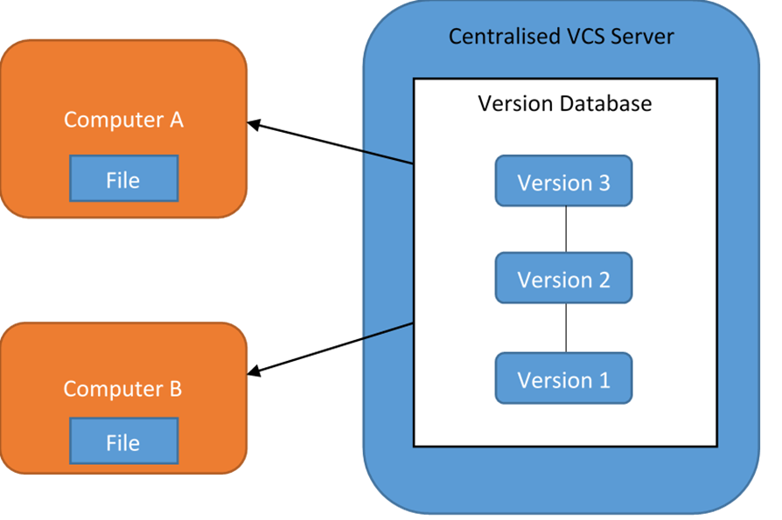
Centralised VCS structure
Architecture revolving around a central server to work on
Allows for ease of collaboration and administration
Major downside is the SPOF – single point of failure
Examples include Subversion and Perforce

Slide 9
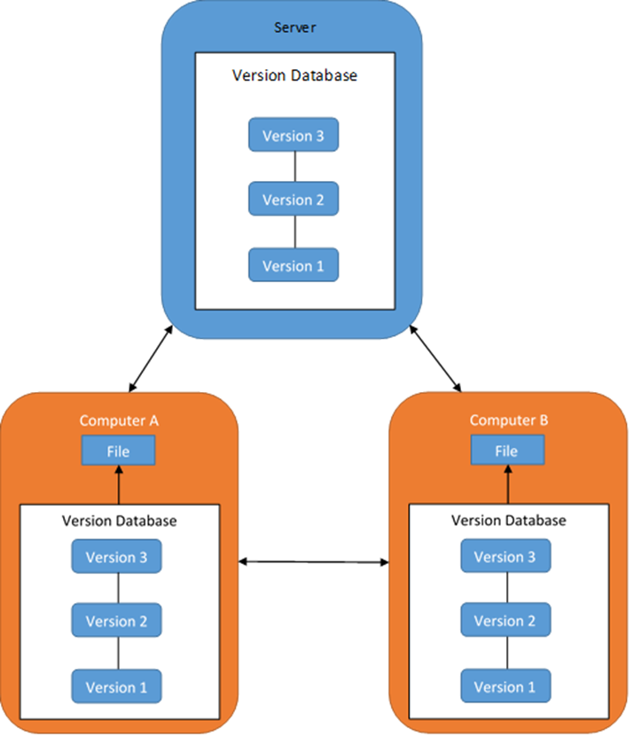
Distributed VCS structure
Work is held on a server, but the repository is mirrored when accessed
Several remote repositories created, which essentially creates back-ups of the central repo
Encompasses a lot of the benefits of CVCS’, without the downside of a SPOF
Examples include Git and Mercurial

Slide 10
Git and GitHub setup
Continuous Integration – Module 2: Git Basics

Slide 11

Git introduction
Arguably one of the most popular DVCS tools in software development
Can be used stand-alone or through inclusion within an IDE
Initially developed in 2005 by Linux mastermind Linus Torvalds
Used in both open-source and commercial environments
Has both a CLI and web-based UI

Slide 12
Why we should use Git
Performance – adding files, committing changes, branching/merging, and versioning is very quick and easy to do through Git
Offline work – mirroring the repository without the need of constant connection to your central server is very helpful
Flexibility – Git can support various workflows for both small-scale and large-scale projects

Slide 13
Installing Git
Windows
Navigate to the Git download for Windows in your preferred web browser: https://git-scm.com/download/win
Click on next for every option and finally click install
The installer adds the Git program to your PATH environment variable, so it can accessed either in the Windows command prompt or by using the Git Bash terminal that was also installed.
Linux
Because of how popular the Git tool is, it can be installed by using almost any package manager that is included with the operating system, below are examples for RHEL/CentOS and Ubuntu.
RHEL/CentOS - sudo yum install –y git
Ubuntu - sudo apt install –y git
Notes:
Linux
Open a command prompt and enter ‘git --version’ to verify your install!

Slide 14
Configuring Git
Git Config
Before you can commit changes to a repository you need to have your username and email configured
This can either be set in the scope of the repository you downloaded or set globally, so that it does not need to be configured for any other repository that you clone
Use the git init command to initialise a Git project (in the project root directory)
git config --global user.name “[USERNAME]”
git config --global user.name “bob”
git config --global user.email “[EMAIL]”
git config --global user.email “bob”
git config user.name “[USERNAME]”
git config user.name “bob”
git config user.email “[EMAIL]”
git config user.email “bob”

Slide 15
Task: Create a GitHub account
To create an account on GitHub
Go to https://github.com/join
Create a GitHub account

Slide 16
Using Git
Continuous Integration – Module 2: Git Basics

Slide 17
Git – Basic Workflow
Working directory
Staging
area
Git directory
(repository
Checkout the project
Stage files
Commit
The basic workflow for using Git includes staging, committing and pushing changes
Staging (git add) – An area where files can be stored, ready for commit
Committing (git commit) – Records changes to local repository
Pushing (git push) – Pushes changes to remote repository (like GitHub)
Why would we want to push to a remote repo?
Notes:
.git (git repo, locally)
Git status > you have added this … “red”, “green”
*Edit my logo *
Git status
Git add .
Git commit –m “ER: uploading logo changes” (-m: message) (
Git push origin branch

Slide 18
Git - cloning
Used to target an existing repository and create a clone, or copy of it
Most common way to obtain a development copy of the project
Cloning automatically creates a remote connection called "origin" pointing back to the original repository
Makes it very easy to interact with a central repository
Main usage:
Make sure you are in the righty directory (where you want the project on your system)
git clone [link to repo]
Notes:
Git clone “url.git”

Slide 19

Git - forking
A fork is a copy of a repository
Allows you to freely experiment with a project, without affecting the original project!
Most commonly used to propose changes, or use as a good starting point for your own project
You could:
Fork the repository (using the GitHub GUI or git clone & then git fork)
Make a change/fix
Submit a pull request to the product owner – they may decide to include your change/fix!

Slide 20
Git - Pull
Git Pull
Because Git is a collaborative tool, other people could have made changes to code in the remote repository
These changes will need to be pulled down to avoid conflicts in the code:
git pull [REMOTE] [REMOTE BRANCH]
git pull origin master
Notes:
Pull (fetch + merge)

Slide 21
Task: Practice with Git
To configure and work with a repository
Go to Community
Complete the Basics, Cloning and Forking modules.

Slide 22
summary
Version control allows us to track code changes within a project
Benefits include traceability, change history tracking and branching workflows
Centralised VCS’ have a central server where everything is accessed
Distributed VCS’ mirror the repo onto each computer that accesses it
Through Git Bash, we can run commands to work with a remote repository
We can clone, pull and fork repositories
Continuous Integration - module 2

Slide 23

Thank you for listening
Any questions?

